Slide 1


Week- Risk Management Basics Dr. Bhuvan UNHELKAR IT Faculty, College Of Business; Office: C225; bunhelkar@sar.usf.edu; 941-359-4654

Slide 2
Sub-Module Project Risk Management
Chapter 11 of
PMBOK ® 5th Edition
© MethodScience; Material Designed and Presented by Dr. B. Unhelkar

Slide 3

Lecture Agenda
What do we mean by Risk Management?
Why undertake Formal Risk Management?
Reducing as well as Capitalizing from Risks
Project Risks –
Relating to PMBOK and SFIA frameworks
Key Points & References
Short exercises, Discussion and Project Work

Slide 4

Sub-Module What is Risk Management?
Fundamentals & Perspective
© MethodScience; Material Designed and Presented by Dr. B. Unhelkar

Slide 5
What is Risk Management?
Risks are Integral to:
Projects, Business, Life
Risks cannot be Total Prevented
In a real, live world
A totally risk-free world would be a dead world
Business is based on Risk
So, Risk-taking is a part of business
Hence we need to Understand and Manage Risks – Particularly in IT context

Slide 6
What is Risk?
PMBOK (PMI) Definition:
An uncertain event or condition that, if it occurs, has an effect on an objective
What we Understand:
Risk is UNCERTAIN (e.g. a Car may crash)
Risk can be an event (in time, such as an actual crash) or an ongoing condition (such as a loose brake pedal)
Impacts an Objective (e.g. cannot reach where we wanted to reach in the car)
Need to Separate Perception of risk from Actual Risk

Slide 7
Why Undertake Risk Management?
Understand Types & Sources of Risk
Plan well-ahead of occurrences of Risk
Reduce the Management of Risk by Crises
Undertake Proactive approach to risk
Put together a Systematic approach to handling Risks
Create opportunities through risks
Improve Competitive Advantages
Gain better Control on Projects
Improve their Chance of Success
Stabilize the situation; reduce further escalation

Slide 8
Managing Risks – Basics
Anticipation
Prevention
Risk Management
Correction
Capitalization
Perception

Slide 9
Expanding the Basics of Risk Management (Fundamentals)
Risk Mgmt
Plan
Identify
Threat!
Opportunity?
Register
Analyze
Prioritize
Respond
Track
Communicate

Slide 10
Project Risks and Impacting Factors
An uncertain event or condition
Whose occurrence can have a Positive or Negative effect on Project Objectives (e.g. Scope, Schedule, Cost and Quality)
Examples include: Immature PM practices, Lack of Integrated mgmt systems, Concurrent projects, Dependencies on external participants outside direct project control
Source/
Cause of Project Risks
Requirements
Assumptions
Constraints
Conditions

Slide 11
Risk Considerations
Risk Appetite:
Degree of uncertainty an entity is willing to take = in anticipation of a reward (this is a wish)
Risk Tolerance:
Degree, amount or volume of risk that an individual or organization can withstand (this is real)
Risk Threshold:
Measures of level of uncertainty or impact above which risk will not be tolerated (this is a metric)
Positive Risks = Opportunities
Negative Risks = Threats

Slide 12
What is Risk Management?
11.1 Plan Risk Management
Defining how to conduct risk Management
11.2 Identify Risks
Determining which risks may affect the project and documenting them
11.3 Perform Qualitative Risk Analysis
Prioritizing risks for further analysis by assessing and combining probability of occurrence
11.4 Perform Quantitative Risk Analysis
Process of numerically analyzing the effect of identified risks
11.5 Plan Risk Responses
Process of developing options and actions to enhance opportunities and reduce threats
11.6 Control Risks
Implementing risk responses, tracking and monitoring risks, identifying new risks…

Slide 13
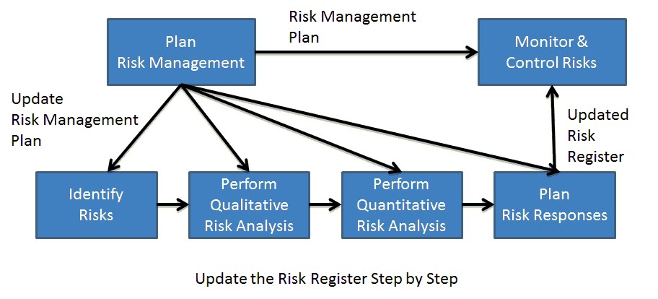
The Risk Management Process
Notes:
http://getpmpcertified.blogspot.com.au/2011/06/chapter-49-big-picture-of-risk.html

Slide 14

Short Exercise – Circle the Best Option
Q 1: In terms of Risk Consideration, state whether the following sentences are TRUE / FALSE:
(a) Risk Appetite: (T/F)
Degree, amount or volume of risk that an individual or organization can withstand
(b) Risk Tolerance: (T/F)
Degree of uncertainty an entity is willing to take on in anticipation of a reward
(c) Risk Threshold: (T/F)
Measures of level of uncertainty or impact above which risk will not be tolerated
Q 2: Performing Qualitative and Quantitative Risks Analysis Feeds into :
Plan Risk Management
Plan Risk Responses
Monitor and Control Risks
Identify Risks
Notes:
1 – a=F; b=F; c=T;
2 - b

Slide 15

Discussion, Q & A, Workshop
Can you think of any additional reasons for Why one should undertake formal Risk Management?
Identify the Risks associated with the Iron Triangle of Project Management in your Case study? (hypothetical)
Also identify what are the Opportunities arising from those risks?

Slide 16
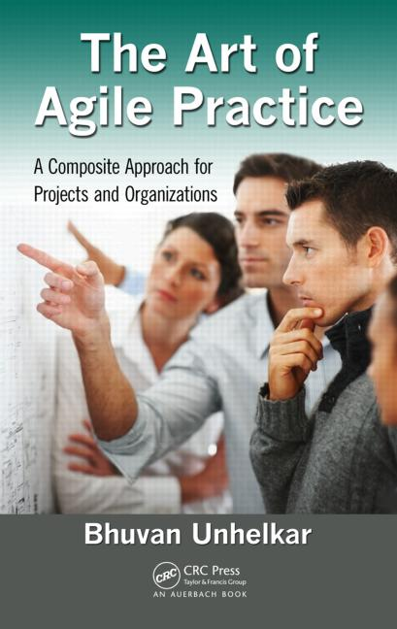
Sub-Module Risk Identification Techniques
System Level
© MethodScience; Material Designed and Presented by Dr. B. Unhelkar; drawn from The Art of Agile Practice

Slide 17
Risk Identification
External (examples)
Technology chosen; Dependency on External Organizations; Governance (Local, Country); Social; Physical environment (weather!);
Internal (examples)
People & Politics; Budgets; Schedules;
Lack of Processes; Lack of Communications;
Lack of Quality & Testing;
Usually a Combination of Above;
Risks cannot be easily Ascertained by a formula
Ongoing Observation Required by the PM
Verbal and Non-Verbal Signs to be Observed
Immense Importance of Grapevine (coffee meetings)

Slide 18
Observe Key Project Moments for Risks… (for example)
Approval of Project;
Launching of Project; Formation of Team and Reporting Structures;
Entry & Exit of Team Members;
Performance Reviews;
Testing and Collating Results;
Individual Events
Births; Deaths; Marriages; Divorces; Graduation Ceremonies etc.
Team Events
Closure of Project (Investment in Future Projects)

Slide 19
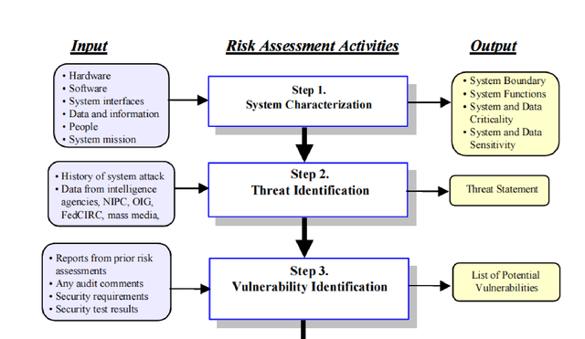
Risk Identification at System Level

Slide 20
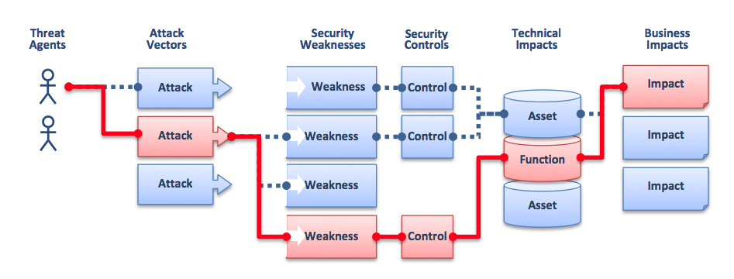
Vulnerabilities open the door to Impact – as the Attacker can slip through them to impact a Function

Slide 21
Assessing Risks: From Known-Internal to Unknown-External
Best chance of Managing
Make them Explicit
Industrial Planning (Consortium-based)
Most difficult to anticipate/ Manage
Known Unknown
External Internal

Slide 22
Short Exercise – Circle the Best Option
Q 1: Risks that are most difficult to anticipate and handle are :
Unknown-External
Unknown-Internal
Known-Internal
Known-External
Q 2: With Tail-Risks, it is:
Easier to identify the Probability but difficult to identify the Impact
Easier to identify the Probability and easier to identify the Impact
Difficult to identify the Probability but easier to identify the Impact
Difficult to identify the Probability and difficult to identify the Impact
Notes:
1-a; 2-d

Slide 23
3.29_Risk_Register

Slide 24


Slide 25
Conclusions & Future Directions
We discussed…??
Do you see what we see?

